Slide 1
Advisory Council for Research Administration
1/27/20
2:00pm – 4:00pm
Medical Campus- L Building 7th Floor - Room L-735

Slide 2

Welcome New Members
Grace Cashman, Sr. Director of Research Administration - BMC
Andrea Gordon, Grants Administrator – ENG
Meredith Hanna, Exec. Director of Administration, Health Law, Policy & Mgmt. - SPH
Jennifer Rogers, Training Manager - PAFO
Andy Soares White, VP Finance Operations
Bettina Stevens, Assoc Dean, Finance & Admin - SAR
Stephanie Wasserman, Director, Grants & Contracts - BMC

Slide 3
Agenda
BU Bridging Project – Open Discussion Mary Beth Dillon (HR)
SP – Updates – Diane Baldwin
PAFO Updates – Gretchen Hartigan
Training Road Map - Jen Rogers
Future Topics Review – Jen Rogers
Draft ACRA Charter – Diane Baldwin
Social Media/Brand Updates - Jen Rogers

Slide 4
SP Updates
New Award Analyst started January 6 – Alexander DaSilva
Two open RA positions
  S/RA Team B – replacing Pricilla Raj
  S/RA Team A – replacing Eric Gibbs
Outgoing Sub-Awards – volumes have substantially increased, leading to challenges in meeting out SLA. We are working on mitigation efforts.
February & March Deadlines – criticality to comply with proposal submission policy. Blog went out Friday and email to all PI’s. Please be sure your RA knows if you have planned proposals.

Slide 5
PAFO Updates
Staffing Update
  Meera joined PAFO as a new RA in November replacing Sal Zaccaria
  Bruna Pereira joined PAFO as a new RA in November replacing Bryce Kelly
  Orson Wells joined PAFO as a biller in November replacing Iris Brito
  Natasha Brown – leaving BU for BC later this month (job is posted)
There will be a portfolio realignment within the next few weeks; we have not done in two years so it is time

Slide 6
PAFO Updates Effort 2.0
Pilot Program held December 12th on Charles River Campus
Workshop / Case Study Approach with a take home Workbook
20-25 Attendees from both CRC and MED Campus
3 Hours in Length
Presenters from both Pre Award and Post Award
Lots of interaction amongst the group

Slide 7
PAFO Updates Effort 2.0 Comments from Attendees
“Loved the interactive / small group workbooks”
“helpful refresher”
“very happy with the concrete case-studies”
“Very beneficial to have pre-award and post-award representation”
“very well organized training”
“I feel I have a better understanding after training”
“I thought the case studies were a fantastic way to present the material”

Slide 8
PAFO Updates Upcoming Training Opportunities
Tuesday, February 11th
  After the Fact Review
  90 Minute session with our colleagues in Financial Affairs including General Accounting, Accounts Payable, and the Cashiers Office
Tuesday, February 25th
  Coffee w/ Colleagues
  Working Title: “Why PAFO always says No – everything you want to know about Audits”
Tuesday, March 24th – Wednesday, March 25th
  2 Day Training for new Research Administrators
Friday, April 3rd
  Effort 2.0
  Deep Dive into Effort for the experienced Department Administrator using Case Study Format

Slide 9
Training Road Map
January
February
March
April
May
June
July
August
September
October
November
December
A year in training* – example year
2-Day DA Bootcamp
2-Day DA Bootcamp
After-the-fact Review
After-the-fact Review
After-the-fact Review
Effort 2.0
Cost Share 2.0
Effort 2.0
Coffee with Colleagues
Coffee with Colleagues
Coffee with Colleagues
*classroom training, online resources are listed on the handout

Slide 10
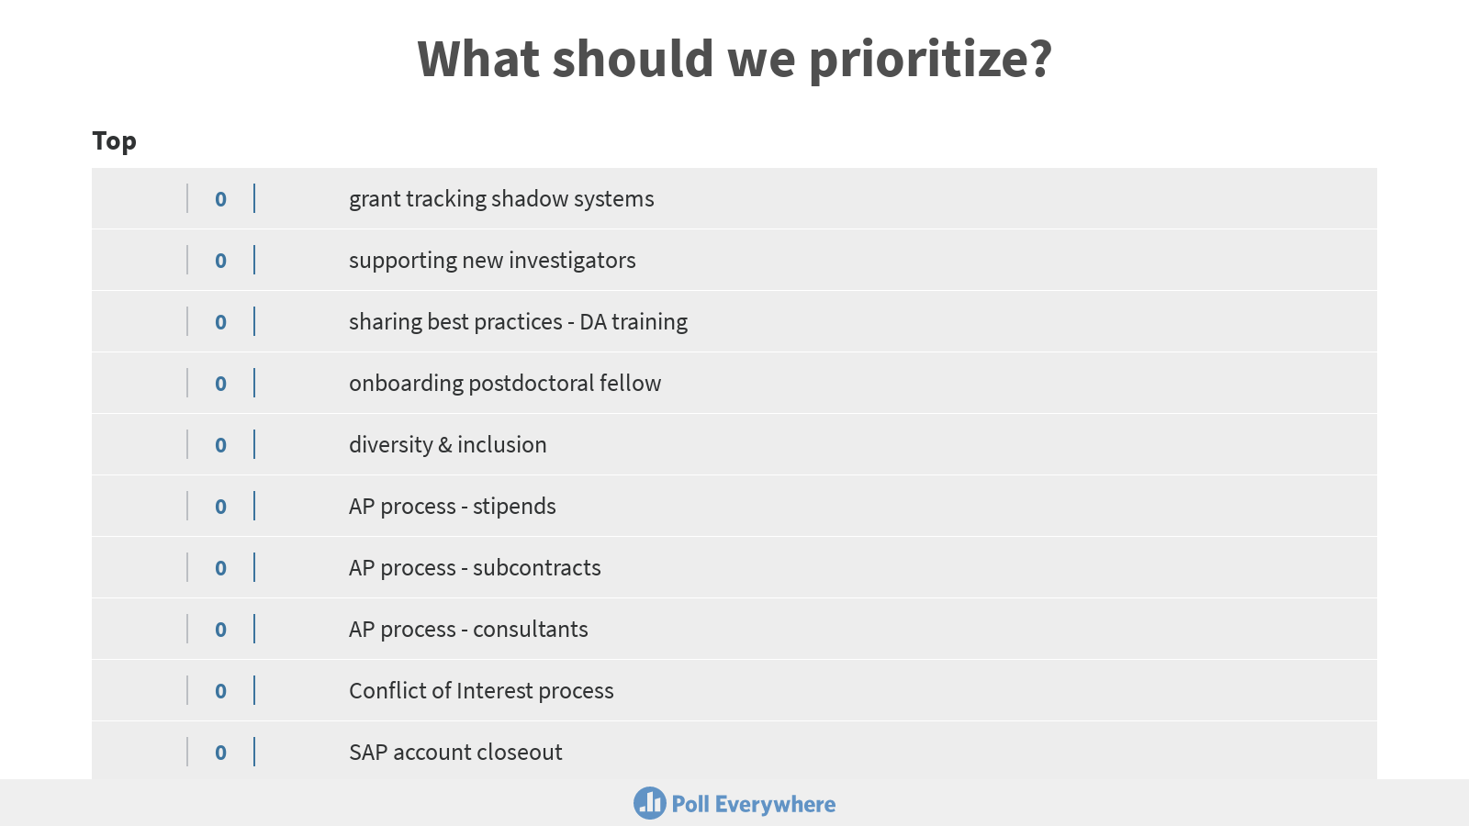
Future Topics Review
Go to www.pollev.com/pafo
Review topics listed and submit additional ideas
Use the arrows on the side to prioritize what you think is most important to cover in the next few months
  Up-vote your top 5 in terms of priority
  Down-vote the 5 you think are least important/urgent

Slide 11
Draft ACRA Charter
Statement of Purpose
Approach
Goals/Objectives
Benefits
Outcomes
Committee Structure
Assumptions
Meeting Structure and Frequency
Static Meeting Agenda
Documentation

Slide 12

Social Media/Brand Updates
Potential communications channels (BU community)
LinkedIn ACRA group
Microsoft Teams
How to encourage/manage membership?
Committee responsibilities re participation?
Potential ACRA logo
Add ACRA membership to LinkedIn profiles?

Slide 13
Closing
Minutes and slides from today’s meeting will be posted on the ACRA webpage
http://www.bu.edu/research/administration/research-support-offices/advisory-council-for-research-administration/
ACRA email: acra@bu.edu

