Slide 1

Office of
Proposal Development
implementing NEW NIH Human subjects guidance

Slide 2
AGENDA
Overview of New Human Subjects Rules
  Definition of a Clinical Trial
  Change in PHS Human Subjects Forms
  Single IRB for multi-site clinical trials
OPD Actions to Address Changes
Implementation of Future Changes

Slide 3
Changes to Human Subjects
All Research Involving Human Participants
New forms to collect human subjects information
Single IRB for multi-site studies
Certificates of confidentiality
Research Involving Clinical Trials
Good Clinical Practice Training
New FOAs specific to clinical trials
New Review Criteria
Expanded registration/reporting on ClinicalTrials.gov
Clinical Trial FOAs
Good Clinical Practice
Registration & Reporting
Single IRB
New Application Forms
Clinical Trial Review Criteria
Notes:
NIH-funded scientists are not publicizing nearly half of the trials they conduct and complete in a timely manner. This is an unacceptable state of affairs. ; slides are text heavy because I meant for them to serve as resource when staff were learning and working with PIs

Slide 4
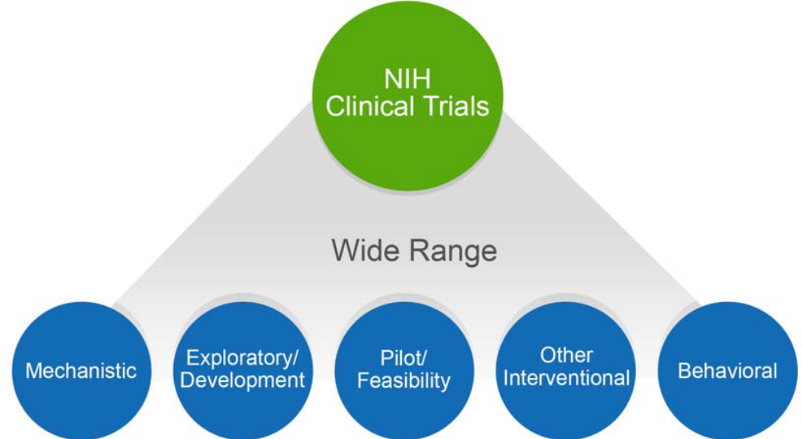
Changes to Human Subjects
Broader definition of a clinical trial….why?
Our purpose in defining clinical trials as we do is to improve dissemination and transparency. The bottom line: if public money is going to be spent to conduct experiments on people, you are expected to report the results.
Video on Updates
Notes:
NIH-funded scientists are not publicizing nearly half of the trials they conduct and complete in a timely manner. This is an unacceptable state of affairs.

Slide 5
Changes to Human Subjects
Does your study:
Involve human subjects?
Involve one or more interventions?
Prospectively assign human subject(s) to intervention(s)?
Have a health-related biomedical or behavioral outcome?
If yes to all- your study is a clinical trial.
NIH Tool to Help Determine if Study is Clinical Trial
NIH Case Studies & FAQs

Slide 6
NIH Clinical Trials
What is the sub-definition of "intervention"?
An intervention is defined as a manipulation of the subject or subject’s environment for the purpose of modifying one or more health-related biomedical or behavioral processes and/or endpoints. Examples include: drugs/small molecules/compounds; biologics; devices; procedures (e.g., surgical techniques); delivery systems (e.g., telemedicine, face-to-face interviews); strategies to change health-related behavior (e.g., diet, cognitive therapy, exercise, development of new habits); treatment strategies; prevention strategies; and, diagnostic strategies.
If all of my participants receive the same intervention/treatment, are these participants "prospectively assigned"?
Yes, it is not a requirement to have multiple treatment groups to be considered prospectively assigned. We do consider single-arm trials to be trials.
Are measurements the same as interventions?
No; measurements are used to collect data, while interventions are used to modify health-related endpoints. A manipulation or modification in one’s behavior or environment for the purpose of measurement alone is not considered a clinical trial.
What types of behavioral manipulations or tasks does NIH consider to be interventions?
A manipulation or task is an intervention if it is used to modify a health-related biomedical or behavioral outcome. However, a manipulation or task used expressly for measurement, and not modification, would not be an intervention.

Slide 7
Changes to Proposal Development process
New Forms-E application packages & FOAs
PHS Human Subjects and Clinical Trials Information Form:
  Use of study record(s)
  New data re: conditions, enrollment, etc.
  Major Changes: All Human Subjects
    Women, minorities and children combined to 1 attachment
    Recruitment and retention plan (new)
    Study timeline (new)
    Data Safety & Monitoring Plan (new for non-clinical trials)
    Overall structure of the study team (new)
  Major Changes: Clinical Trials
    Protocol synopsis and intervention narratives
    Statistical Design & Power
    Dissemination Plan

Slide 8
Final Rule & Single IRB
Studies that have not undergone initial IRB review will be subject to new Final Rule requirements
Research ongoing on that date continue to be subject to current Common Rule
Single IRB for cooperative research to go into effect January 20, 2020
Single IRB for Multi-Site Research:
Domestic sites participating in multi-site studies involving non-exempt human subjects research funded by NIH are expected to use a sIRB
sIRB costs can be direct or indirect charge to an NIH award as long as such costs are reasonable and consistent with cost principles
  Currently, IRB fees would not be charged as direct costs at BU
  Exceptions can be made where federal/tribal or state law/regulation prohibit sIRB
  sIRB not applicable for K, T, or F (guidelines on exceptions here)
The following are examples of types of IRBs that could be used:
  An institutional IRB that is associated with either the awardee or a participating site;
  An independent, commercial or unaffiliated IRB; or
  A central IRB organized to review the proposed study.
Instructions for writing a sIRB plan and providing the justification for exceptions to the sIRB policy within Section 3.2 of the Study Record in the grant application are provided in the PHS Human Subjects and Clinical Trials Information Form Application Guide.

Slide 9
Common PI Questions
Are multiple study records required?
Do I select exemption 4 or “not human subjects research??
Am I require to address Data Safety & Monitoring Plan for non-clinical trials?
Do you have examples of single IRB plan? Do I need to incorporate this into my budget?
How much of the research approach (recruitment, statistical analysis plan, etc.) should go into the PHS forms? Will it be viewed as “overstuffing?” Inclusion of statistical analysis in research strategy and PHS forms?

Slide 10
OPD Actions
Alerted investigators with upcoming grant regarding expected changes
Developed internal training for OPD staff
  SRAI conference materials
  “Cheat Sheet” slides
  Examples of checklists for clinical v. non-clinical trial
Feedback among team members (lessons learned) after first review cycle
Shared resources and materials from partner organizations
Notes:
Internal concerns: what if OSP interprets CT or non-CT differently and we have to re-do the FOA?

Slide 11
Moving Forward
What did our peers do?
Newsletters to faculty with notice of coming changes and dates for trainings
Trainings hosted in Fall 2017 Semester
  Led by central office or medical school research development office
How do we approach large federal changes moving forward?
Early communication and training
OSP Blog & Coffee with Colleagues
Collaborative meetings, rather than presentation, with partner offices (ex. IRB approach from implementation for review; we approached with questions about implementation for proposal development)
Other forums for internal training? Ways to reduce duplication of efforts?

